Slide 1
Design of Adaptive Motor Controller with Built in Microcontroller and I²C Control
Senior Design Project
Justin Derickson

Slide 2
Objective
The objective of this project is to develop a standalone system that will address power distribution, motor and servo control, and general input and output in a single unit.
Notes:
Asked by a colleague to help troubleshoot some wiring issues with a research project.
Diagrams were not kept up to date.
Electronics enclosure was crowded and disorganized.
Total disassembly was required to fix issue.

Slide 3
Design Requirements
Two sets of requirements:
Input and Output Requirements
Power and Control Requirements
System should be small and inexpensive.
Hardware and Firmware requirements

Slide 4
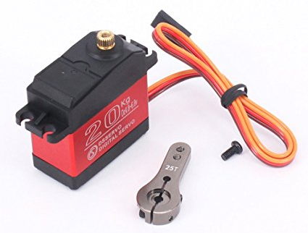
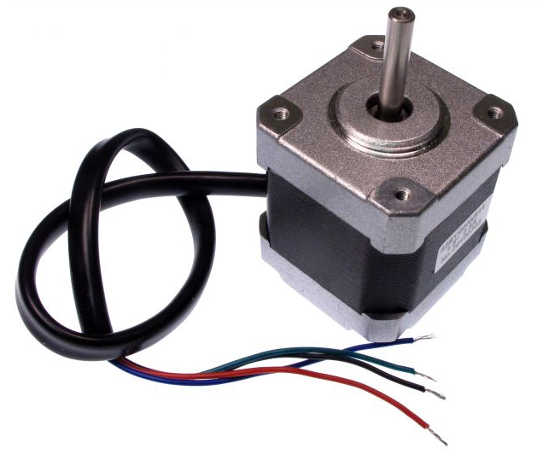
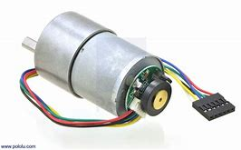
Design Requirements: Input and Output
Control a single bipolar stepper motor or up to two DC motors
5 - 24V operating voltage
1.5 A maximum current per winding or motor
general purpose I/O for quadrature encoder feedback
PWM output for stepper motor control

Slide 5
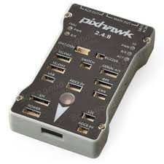
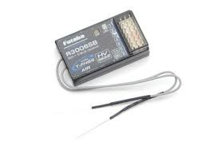
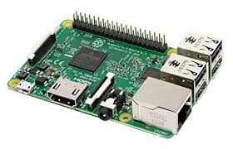
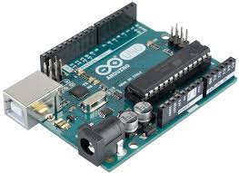
Design Requirements: Power and Control
power supply voltage from 9 - 24 V
provide a stable 5V source to power external devices
I2C and PWM compatible
General I/O
Notes:
I2C would like come from a raspberry pi or arduino.
PWM would likely come from an RC receiver.
PWM more likely to control lower level functions like throttle and steering.
I2C and onboard switches will dictate higher functions

Slide 6
Design Constraint
Budget

Slide 7
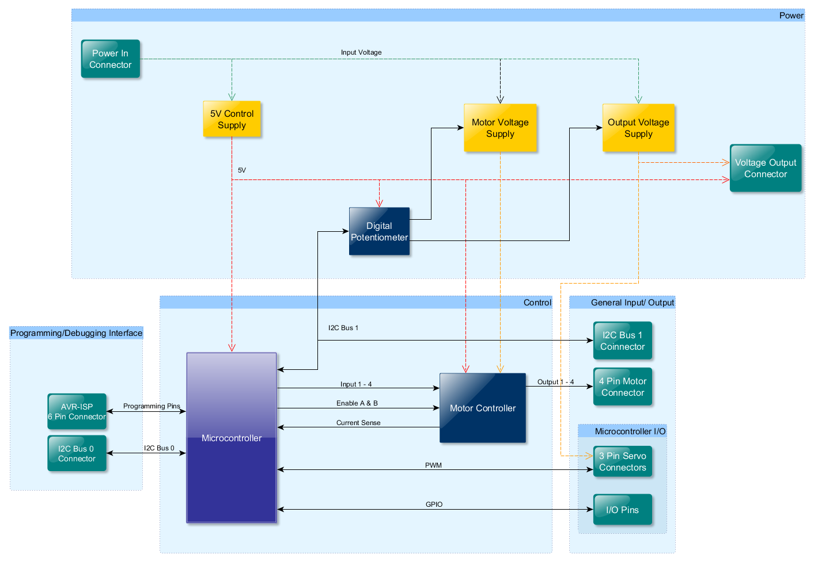
System Diagram
System Diagram:

Slide 8
System Functions
Motor Driver:
Accept logical input for bipolar stepper motor control.
Allow for DC motor control using came connections as stepper motor.
Microprocessor
Supplies control logic to motor driver.
Communicates with external devices.

Slide 9
Task List
Task 1. Control System Design
Task 2. Power System Design
Task 3. Verification
Task 4. PCB Design
Task 6 Final Assembly and Testing

Slide 10
Implementation
of Tasks
Projected Timeline and Delivery Plan over 45 weeks
Circuit Design Week 1 - Week 10
Prototyping / Testing Week 11 - Week 13
PCB Layout Week 14 - Week 17
Firmware Coding Week 18 - Week 21
Assembly and Testing Week 22 - Week 24

Slide 11
Task 1 Control Section Design

Slide 12
Task 1: CircuitMaker by Altium
Free
Large, community-driven component database
Components linked to footprints and vendors
3D-Rendering capability

Slide 13
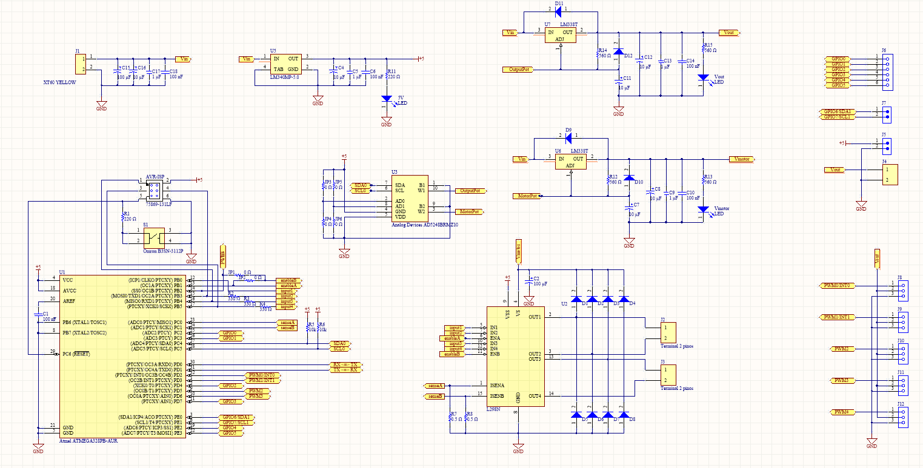
Finalized Schematic

Slide 14
Task 1: Control Section Design Motor Driver
Requirements
Implement Full, Half, and Microstepping in a Bipolar Stepper Motor.
Independent dual DC motor control.

Slide 15
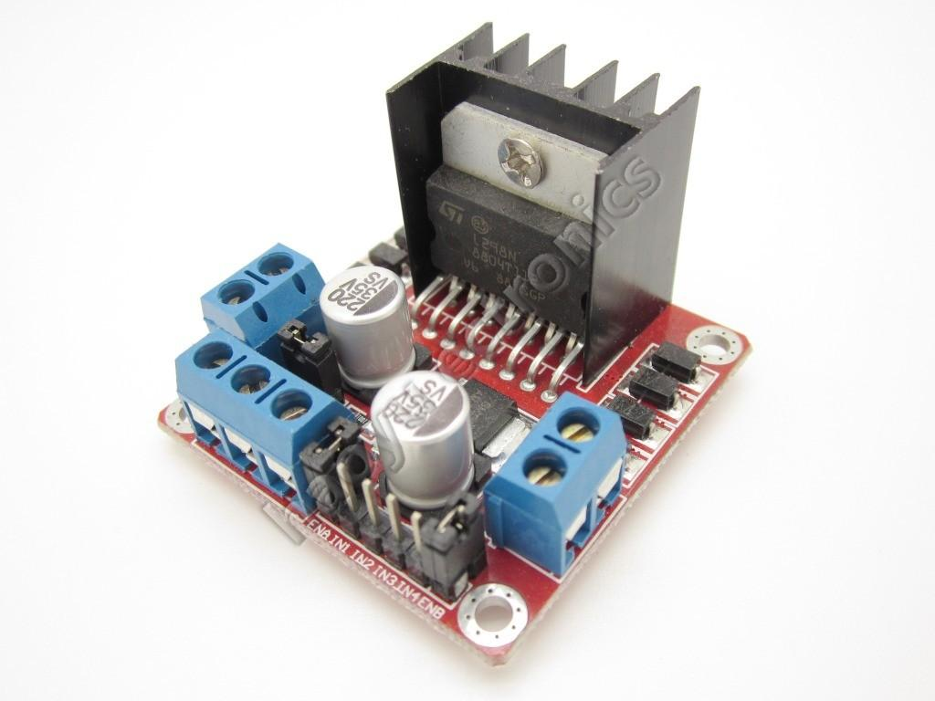
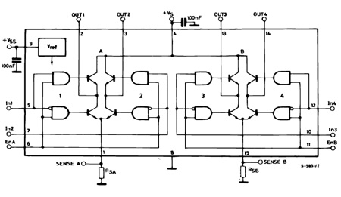
Task 1: Control Section Design Motor Driver: L298N
L298N Dual H-Bridge
Max Supply Voltage 48V
Logic Supply Voltage 5V
Total DC current 4A
Enable pin for each winding
Current Sensing
Notes:
More complex drivers reduce flexibility of use.

Slide 16
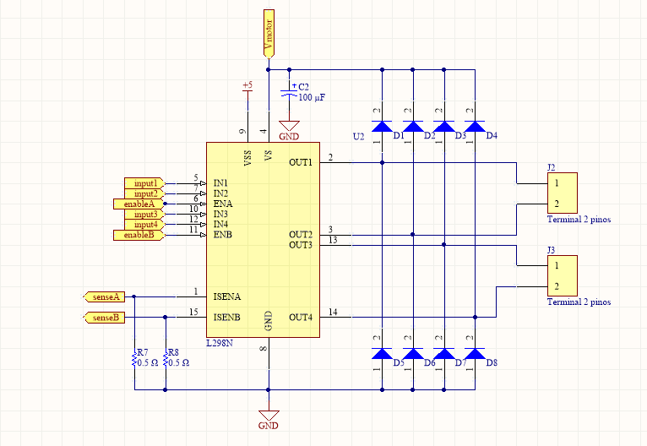
Task 1: Control Section Design Motor Driver:
Schematic
Notes:
Sense Resistors are 25W 0.5Ω
Diodes are 2A fast switching types to handle back EMF

Slide 17
Task 1: Control Section Design Microcontroller:
Requirements
I2C and PWM for device and sensor interfacing.
UART for USB Programming.

Slide 18
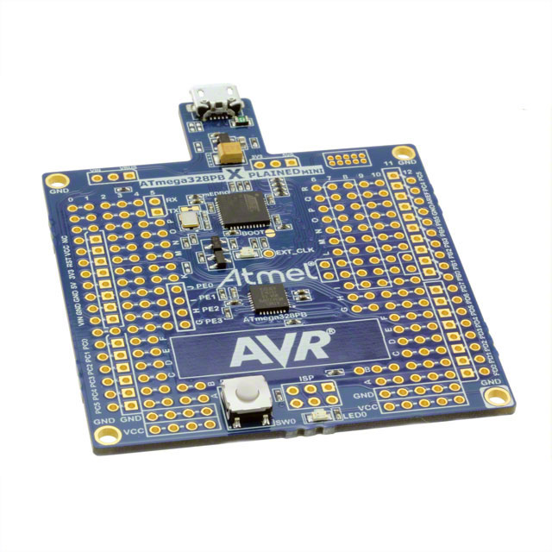
Task 1: Control Section Design Microcontroller: ATmega328PB
Operating Voltage: 1.8 to 5.5V
Memory: 32KB
Programmable Flash: 1KB EEPROM 2KB SRAM
CPU speed: 20 MIPS @ 20MHz
PWM Peripherals: 10 channels
Communication Peripherals: 2-UART, 2-SPI, 2-I2C
Notes:
Updated Version of the uC on the Arduino Uno.
AVR microcontrollers have more support than most other devices.
Inexpensive development boards with built in debugging are available

Slide 19
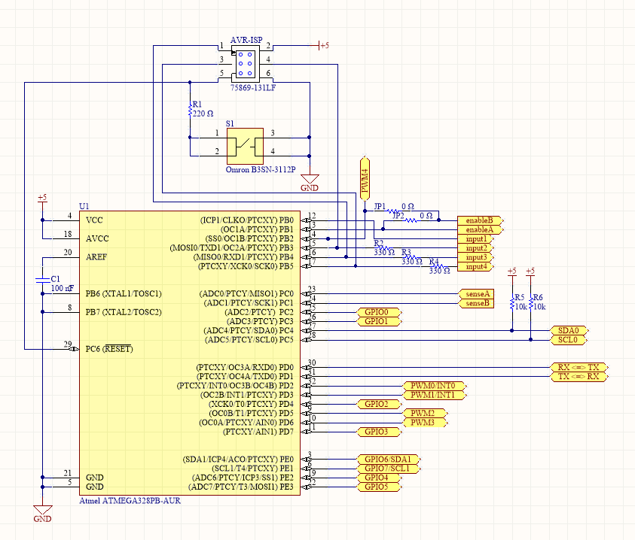
Task 1: Control Section Design Motor Driver:
Schematic

Slide 20
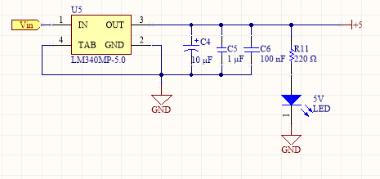
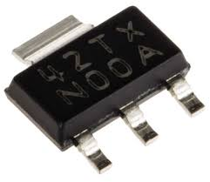
Task 2 Power Section Design 5V Supply
LM340MP Linear Regulator
Operating Voltage 7.5V - 35V
Output voltage 5V
Output Current 1A
Notes:
Current Calculations

Slide 21
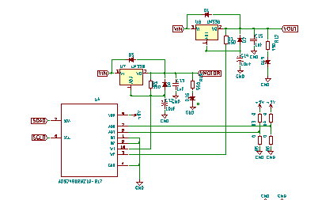
Task 2: Power Section Design
Two Separately controllable voltage regulators
Controlled by a single I2C dual channel digital potentiometer

Slide 22
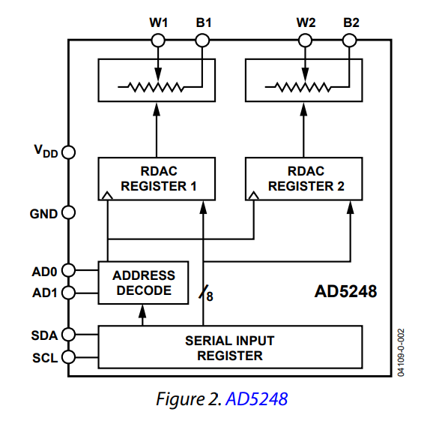
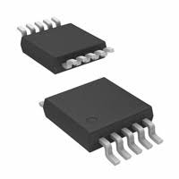
Task 2 Power Section Design: Digital Pot
AD5248BRMZ10
I2C compatible
2-Channel, 256 position potentiometer
10kΩ end to end resistance
Single supply 2.7v to 5.5v
Notes:
While this component is designed as a LED driver, It produces a PWM output easily configured for operating servos.

Slide 23
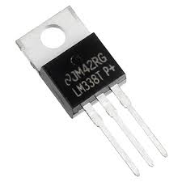
Task 2 Power Section Design Variable Supply
Schematic
LM338 Adjustable Linear Regulator
Operating Voltage: 4.2V - 40V
Output voltage 1.24V – 32V
Output Current 5A

Slide 24
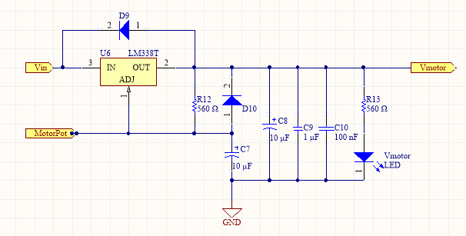
Task 2 Power Section Design Variable Supply
Schematic
C9 improves transient response.
C8 improves ripple rejection.
D9 & D10 provide discharge path around regulator.
Notes:
C9 improves transient response. C8 improves ripple rejection. D9 & D10 provide discharge path around regulator output.

Slide 25
Task 4 : System Verification

Slide 26
Task 4 Design Verification
the ATmega328PB Xplained development board
Inexpensive: $9.00 on Amazon
DebugWire: Debugging through ISP port using serial communication on RESET pin
Arduino Compatible: Arduino header connectors can be added to board for debugging using arduino.

Slide 27
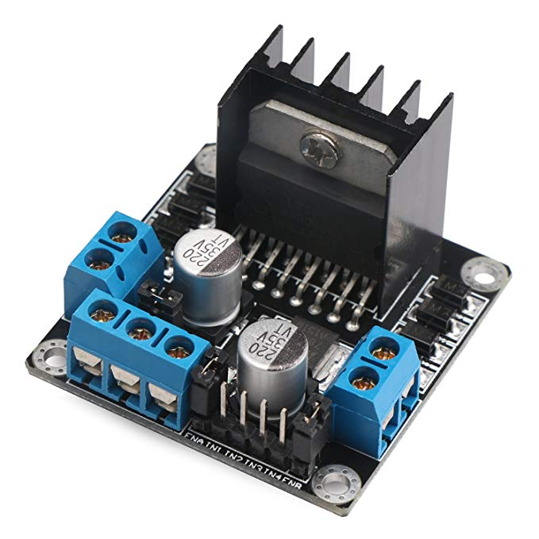
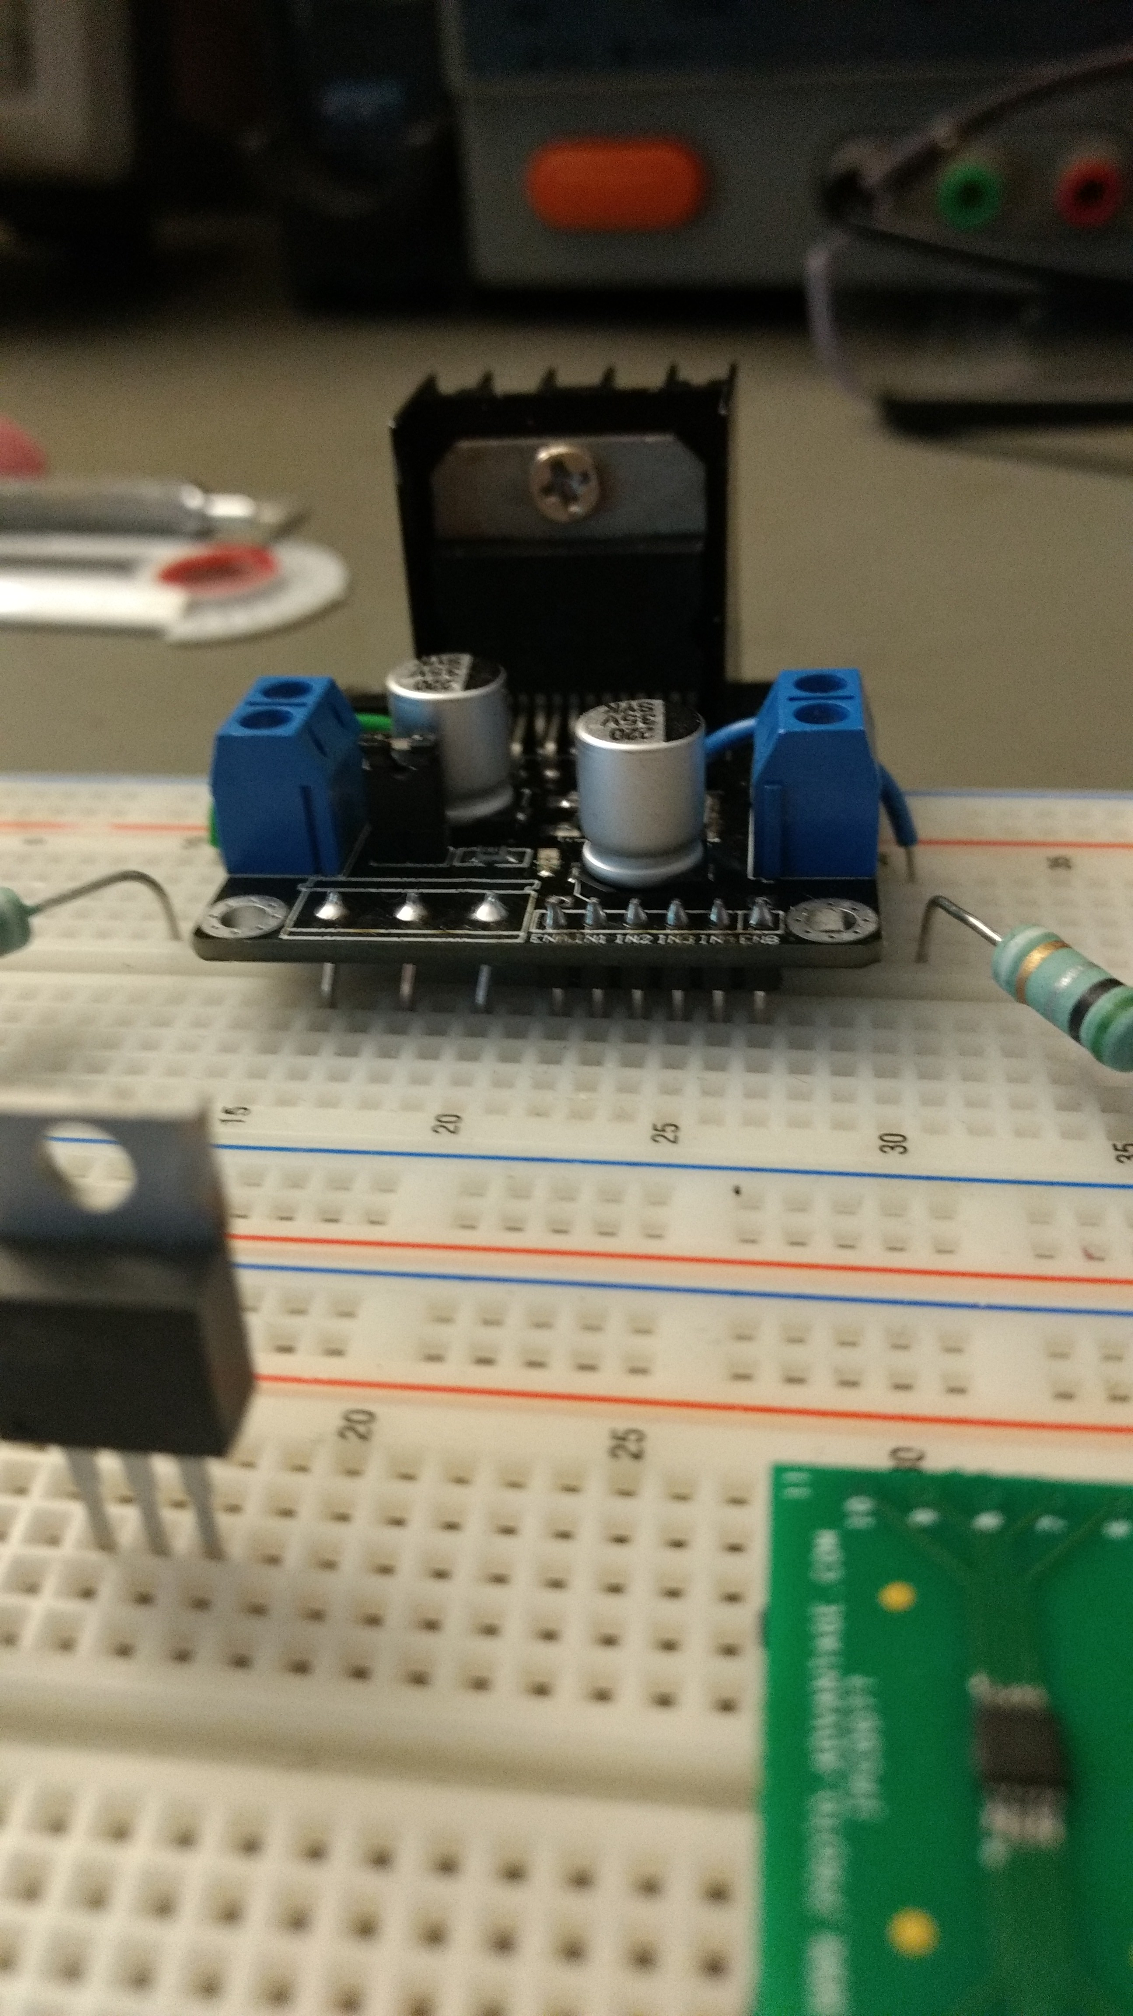
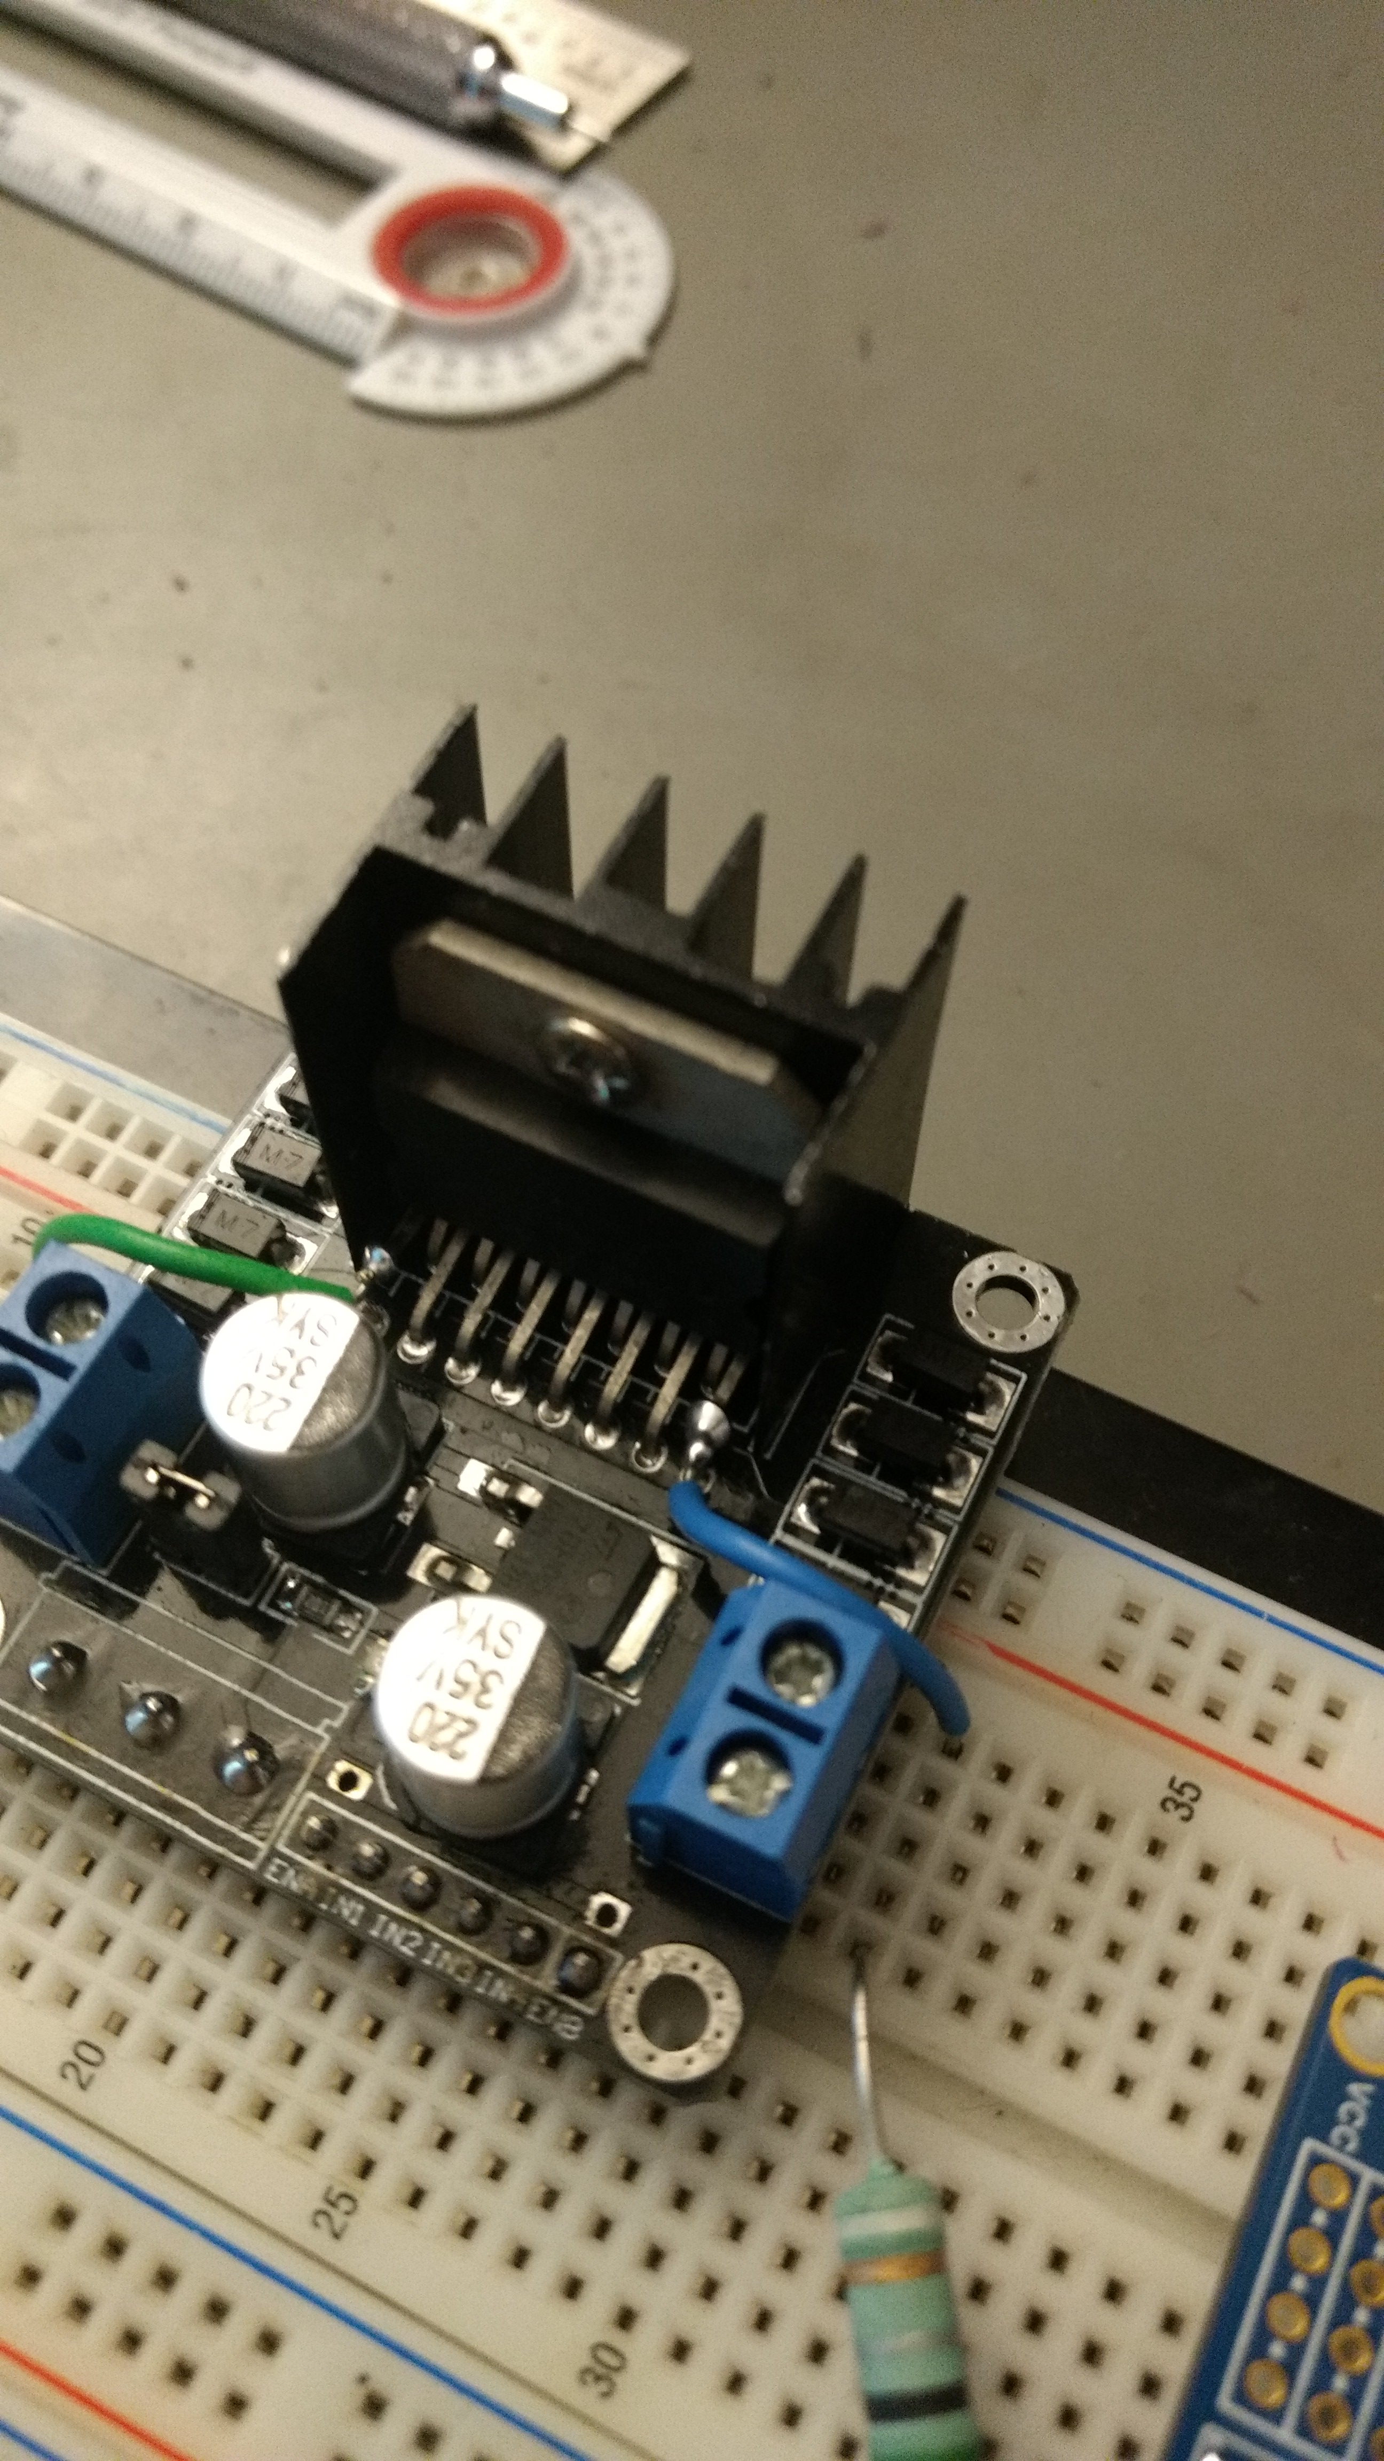
Task 4 Design Verification L298N Motor Driver Board Modifications
Replaced Power, Input, and Enable connectors with breadboard compatible header pins
Cut Sense Pins from board to connect 0.5 Ω current sense resistors.

Slide 28
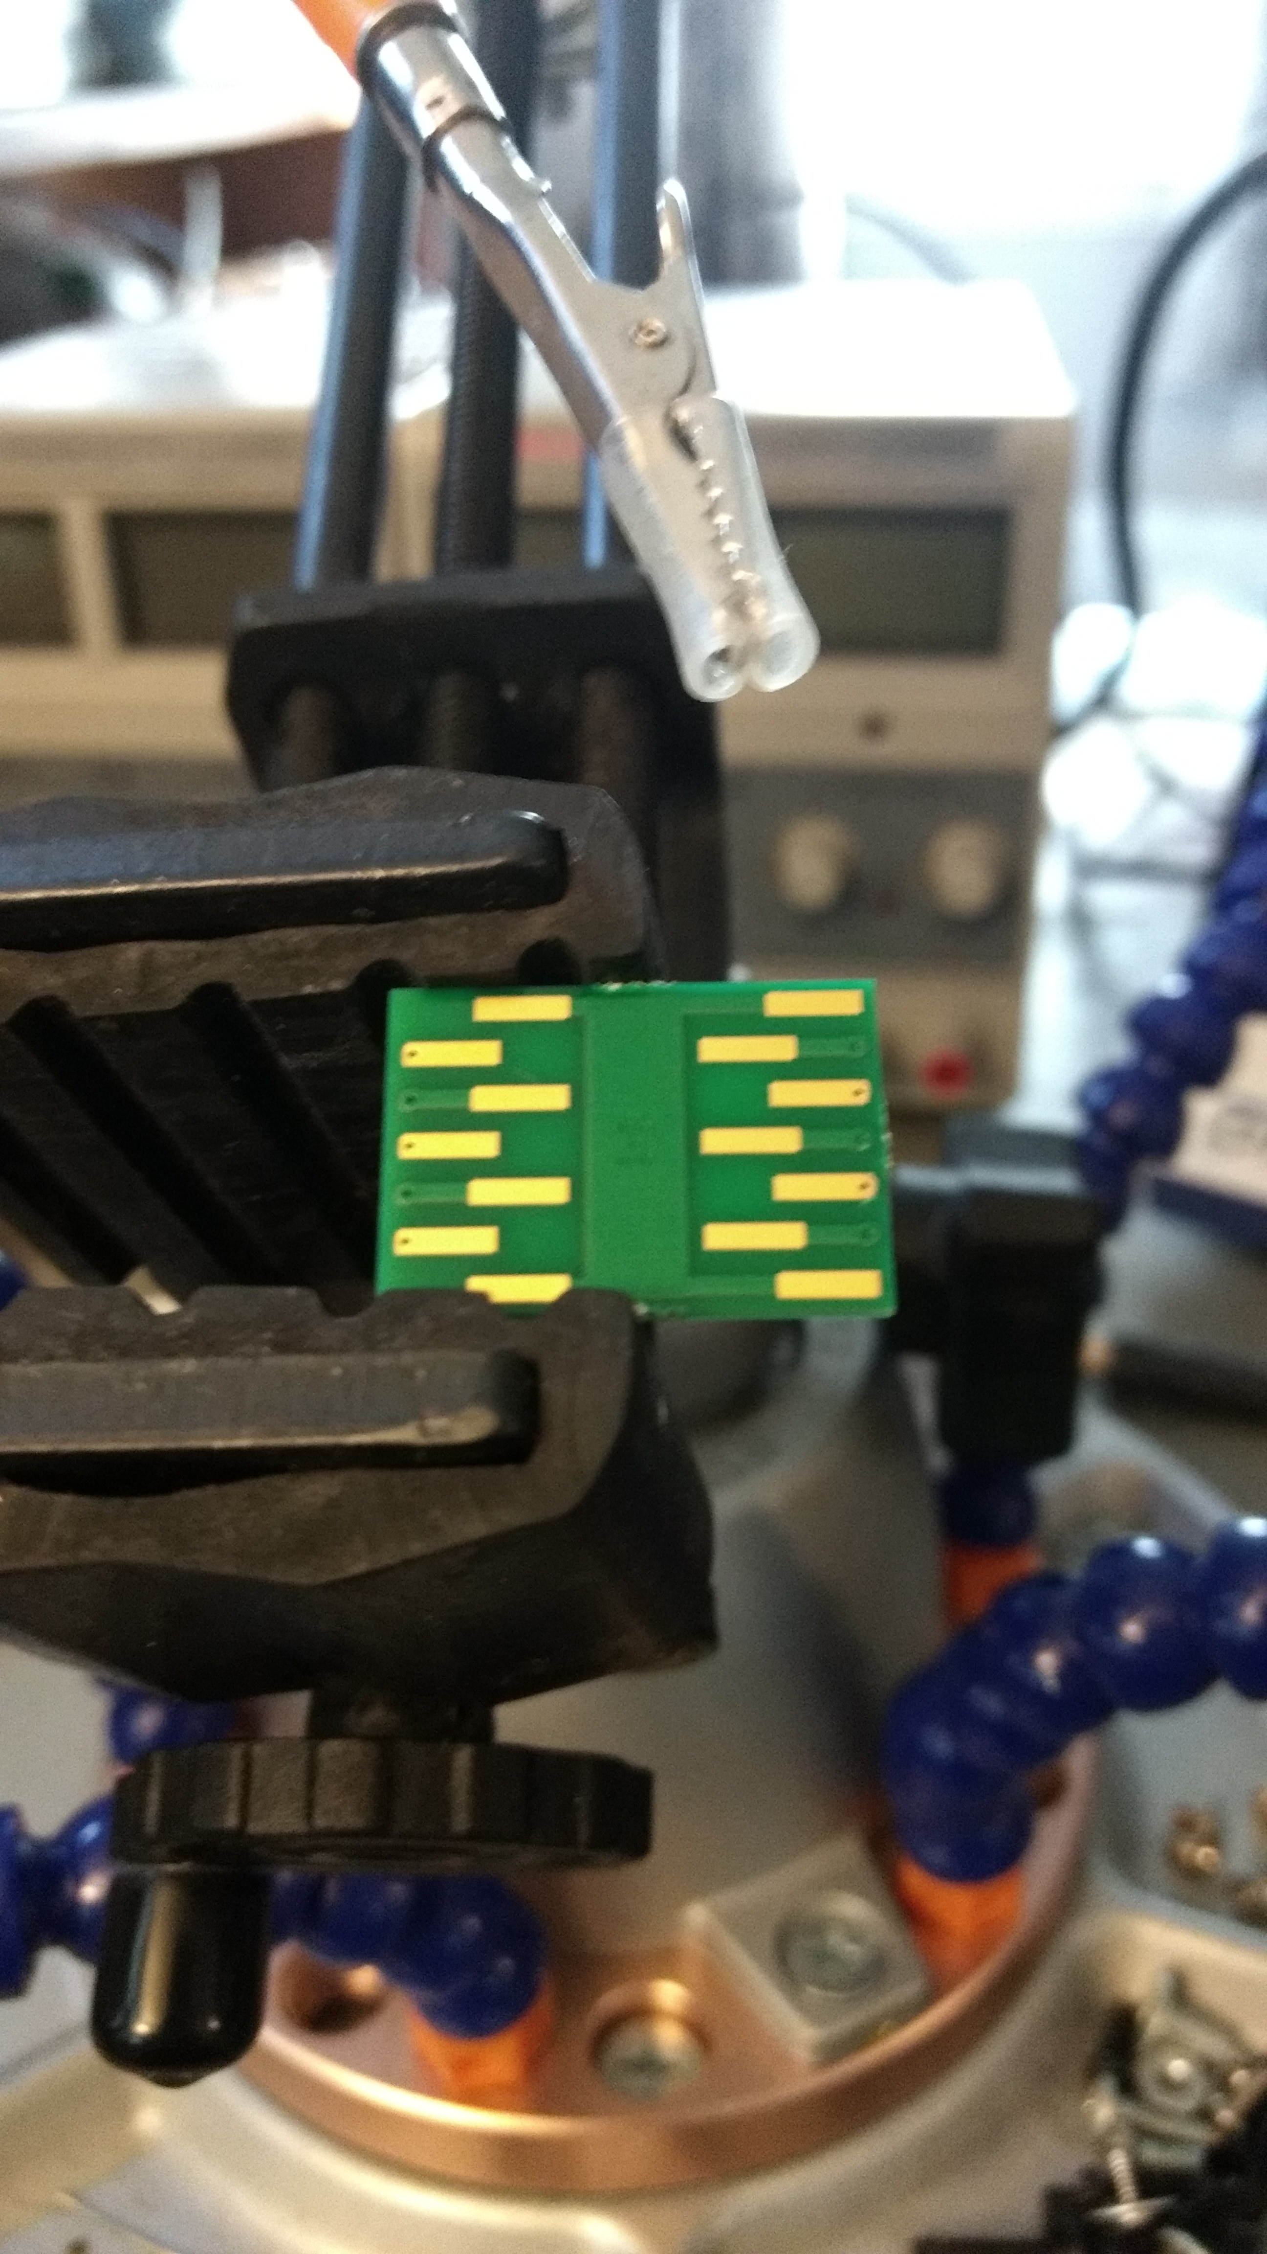
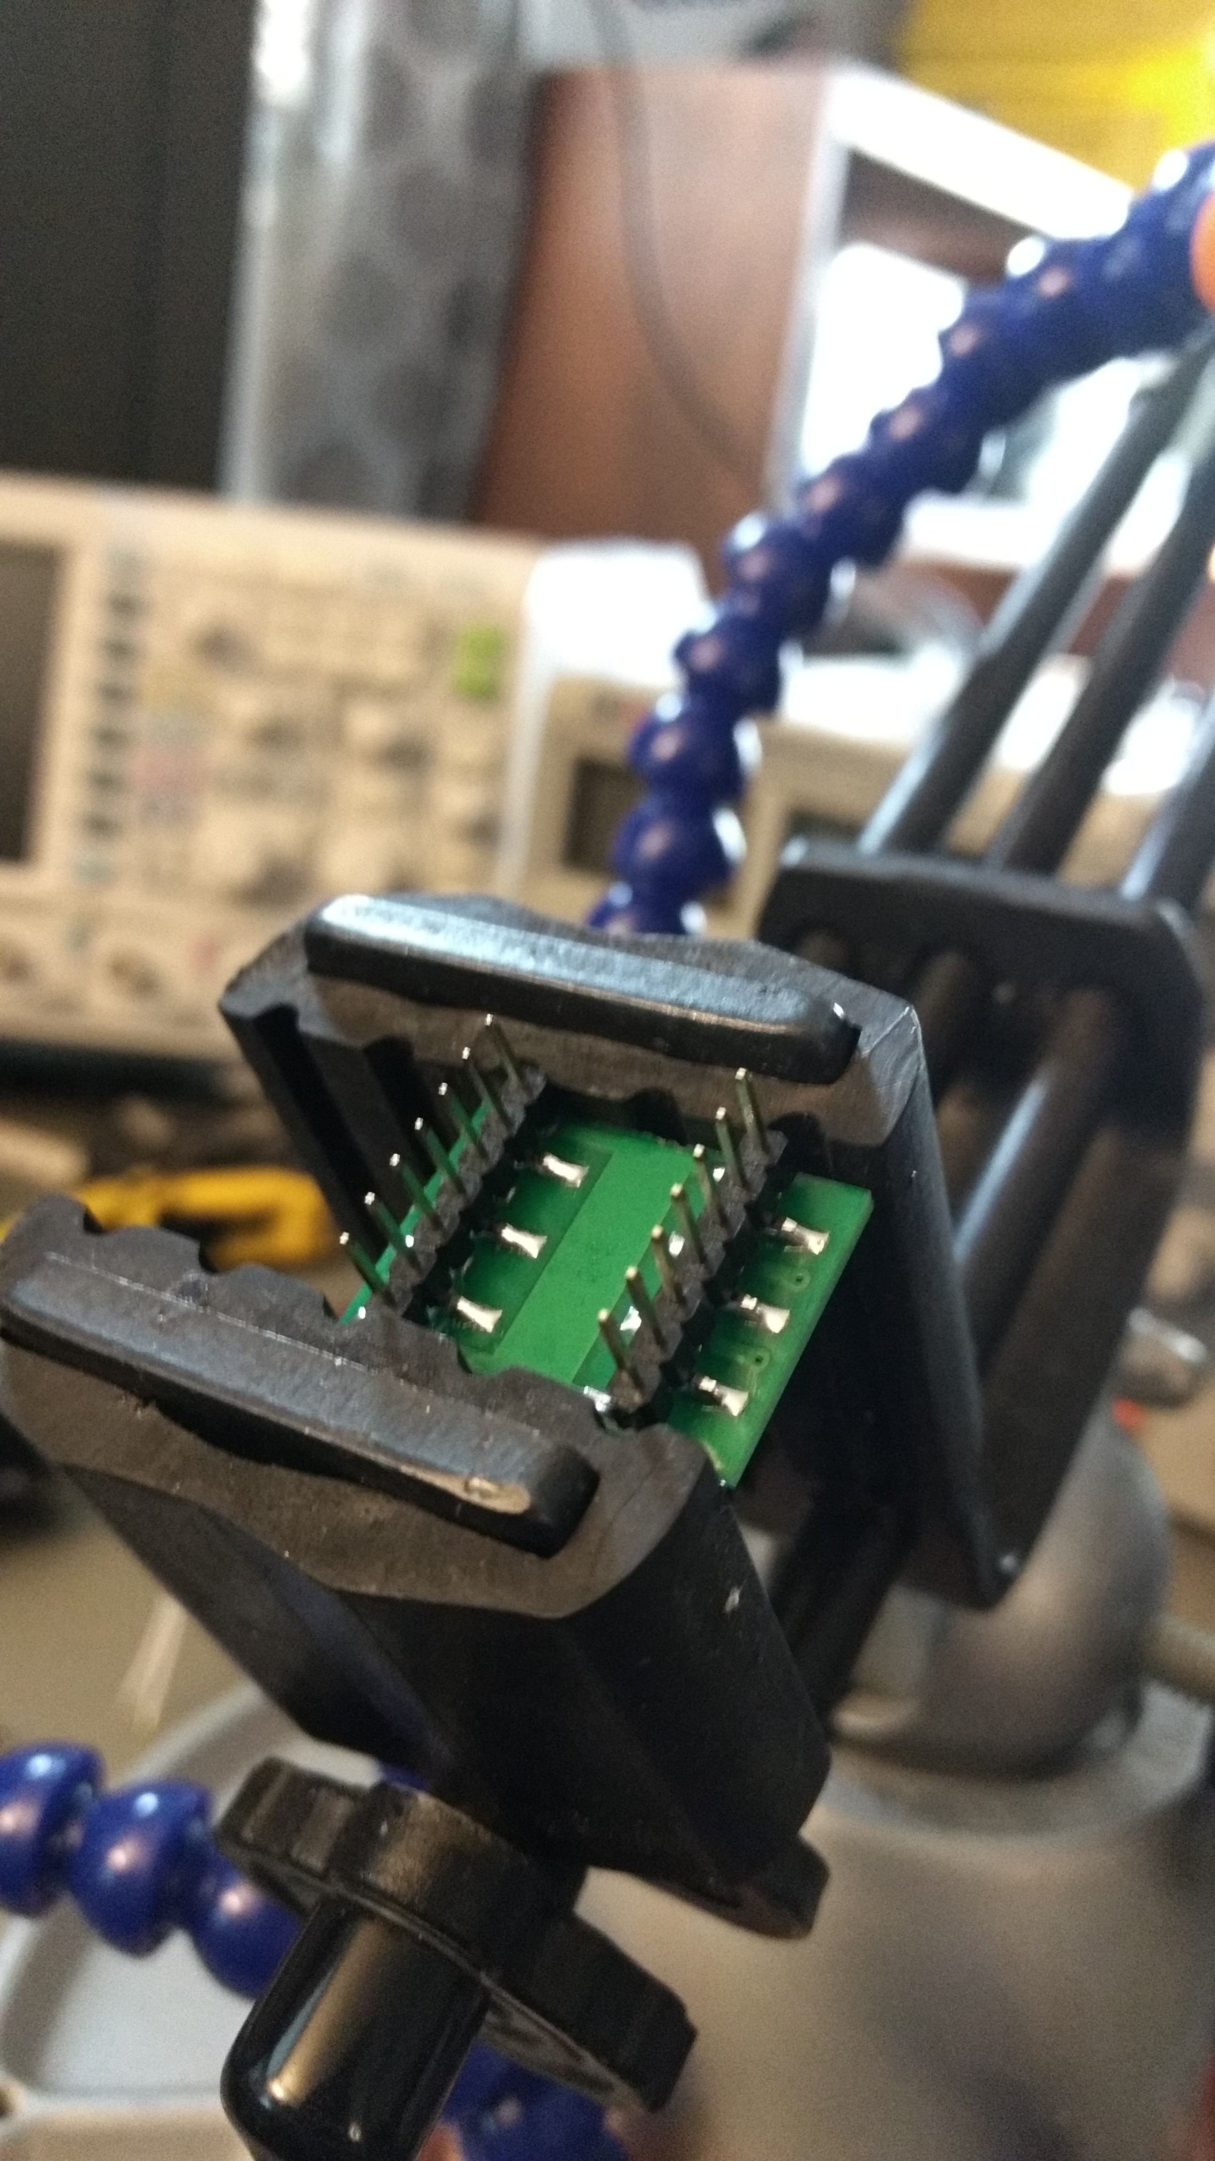
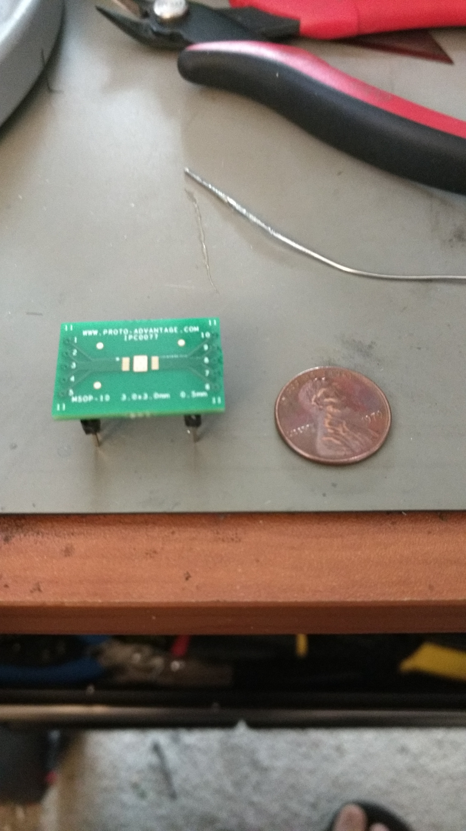
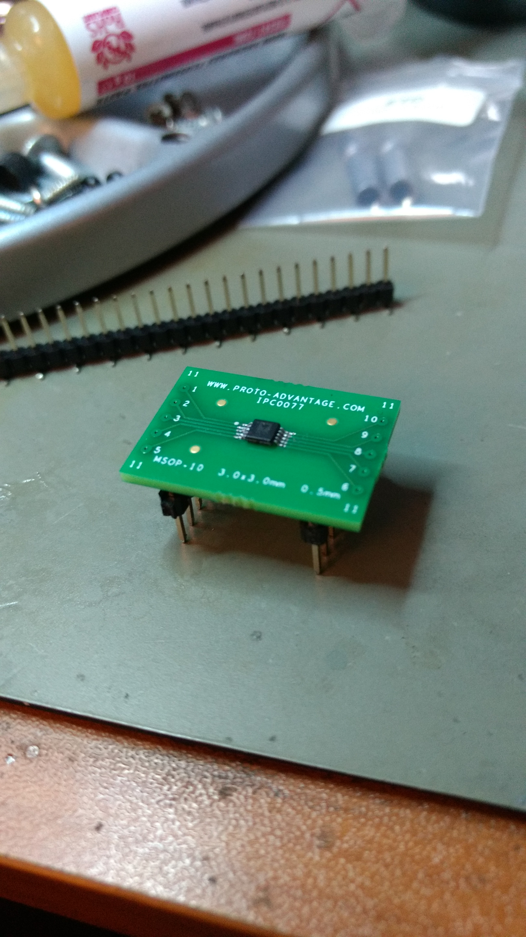
Task 4 Design Verification Digital Potentiometer Breakout Assembly

Slide 29
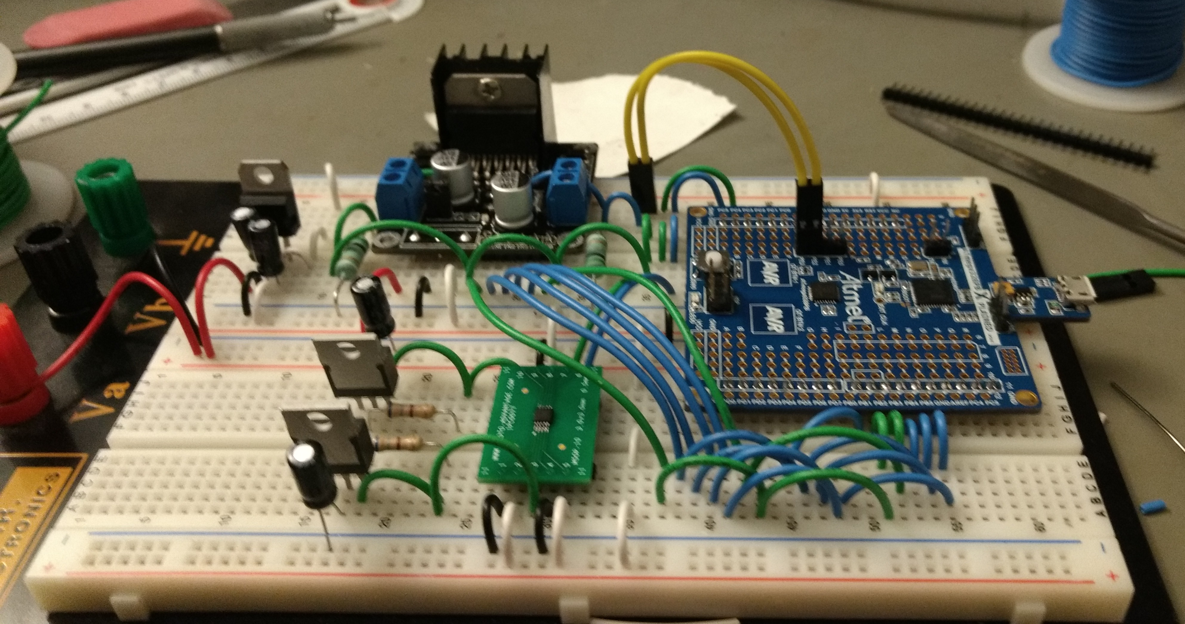
Task 4 Design Verification Completed Test Assembly
Notes:
Connect bottom ground and add 10k pull up resistor

Slide 30

Task 4 Design Verification: IDE Selection
Atmel Studio
Free
Compatible with multiple AVR programmers
Software Simulation for most AVR microcontrollers

Slide 31
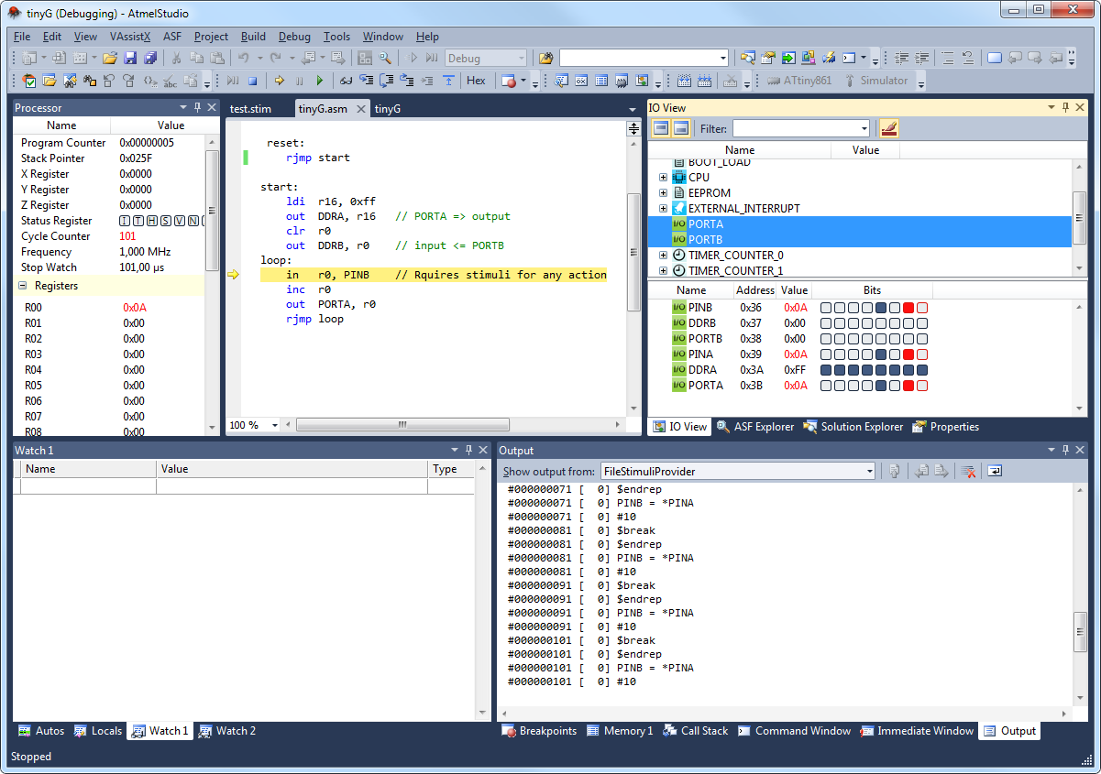
Simulated Stimuli on Atmel Studio

Slide 32
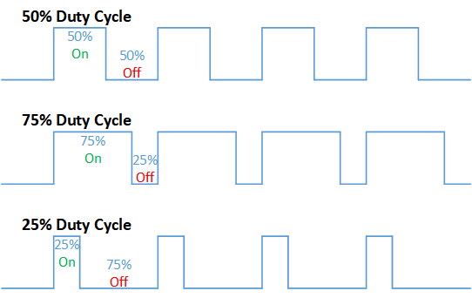
Task 4: Control Section Design Microcontroller: PWM
A modulation technique that encodes information into the width of a regular pulse.
Current control can be achieved by varying the amount of time that a device is on.

Slide 33
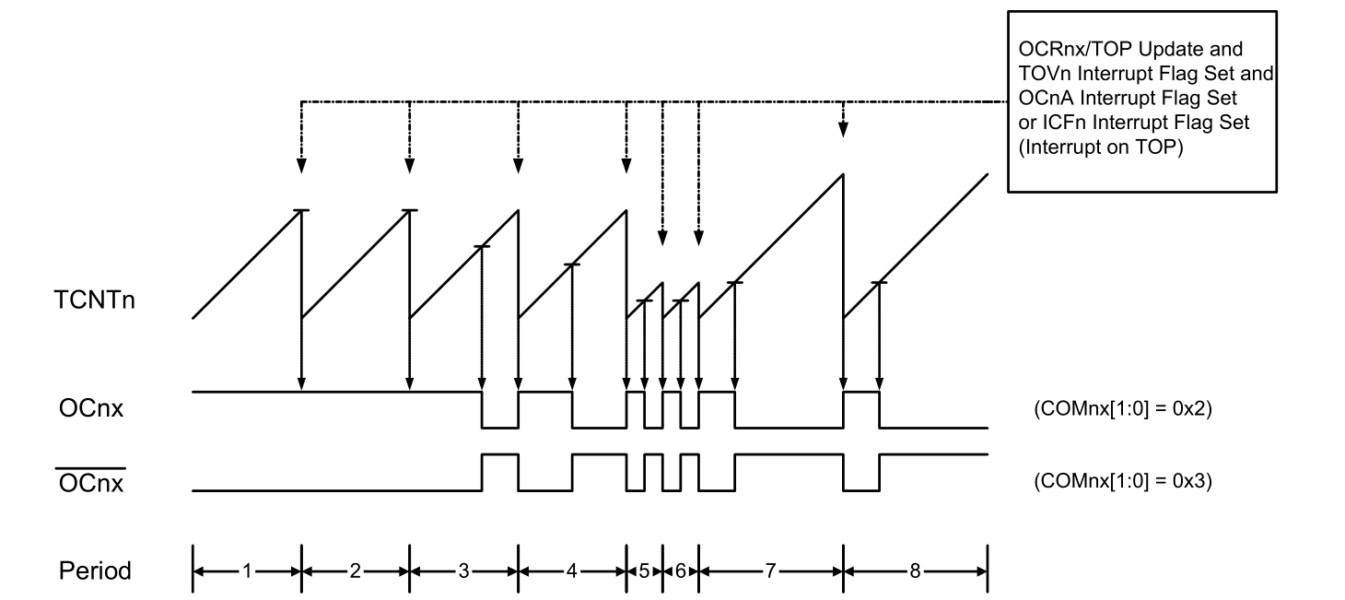
Task 4
Fast PWM on AVR Microcontrollers
Notes:
TCNTn is a timer that counts up and resets at the specified PWM resolution.
The pin state changes on interrupt when TCNTn value equals the value of OCRnx.
OCRnx determines the duty cycle.

Slide 34
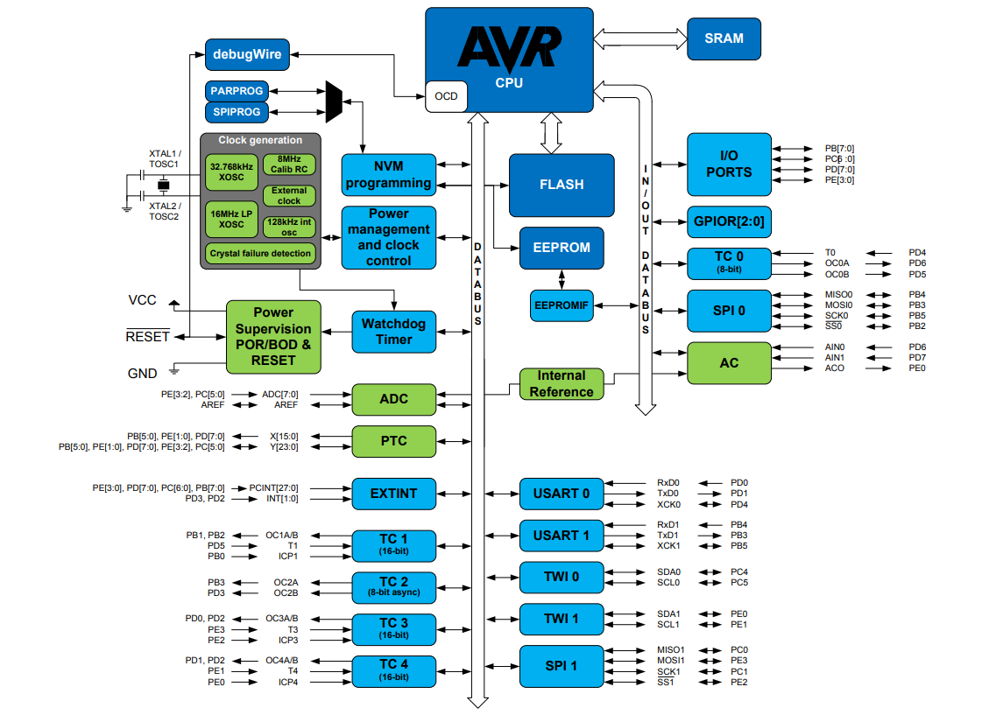
Task 4
ATmega328PB Block Diagram
Notes:
Used to determine which timer controls the PWM on the desired pin.
PB1 and PB2 are both located on the same timer so both PWMs can be configured at the same time.

Slide 35
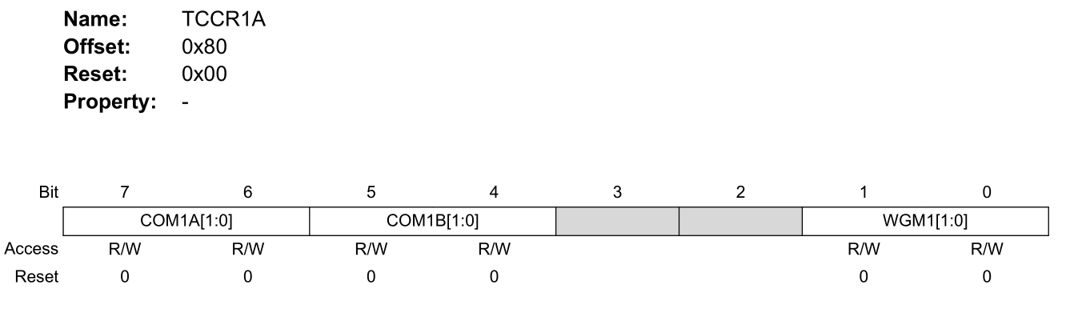
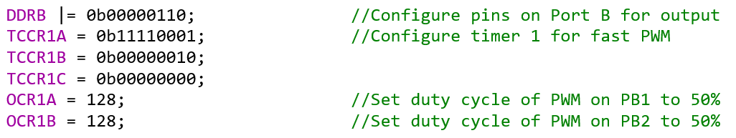
Task 4
PWM setup on the ATmega328PB
Notes:
Code snippet set up PWM with %50 Duty Cycle on pins PB1 and PB2
Lines 1: sets the data direction register to configure PB1 and PB2 as outputs.
Lines 2-4: connects the timer to one or both pins , selects the PWM resolution and type
Lines 5-6: sets the duty cycle to the PWM on each pin

Slide 36
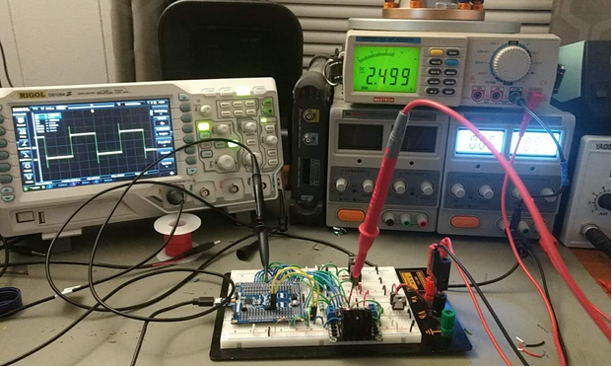
Task 4
PWM setup on the ATmega328PB
Notes:
PB1 output shown on oscilloscope screen.
Average value of PWM on multimeter screen

Slide 37
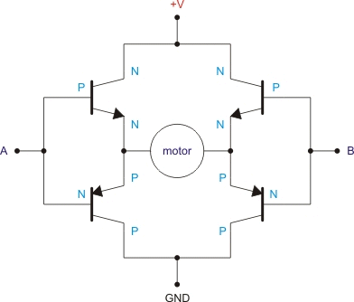
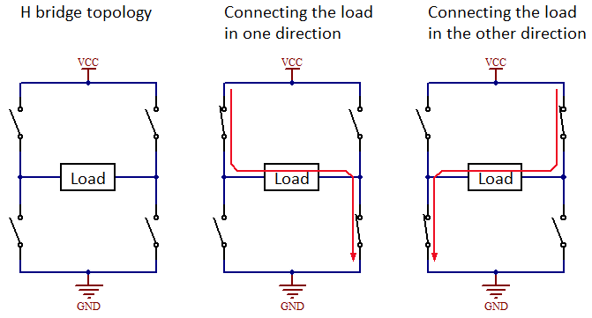
Task 1: Control Section Design Motor Driver
H-Bridge
Change direction of current through load.
Change current through load with Enable

Slide 38
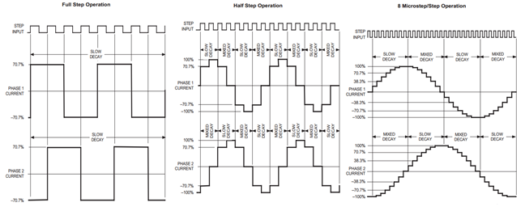
Task 1: Design Verification Motor Control
Dual DC Motor Operation
Vary input logic for different combinations of forward, back, and stop
Use PWM to vary power to each motor individually

Slide 39
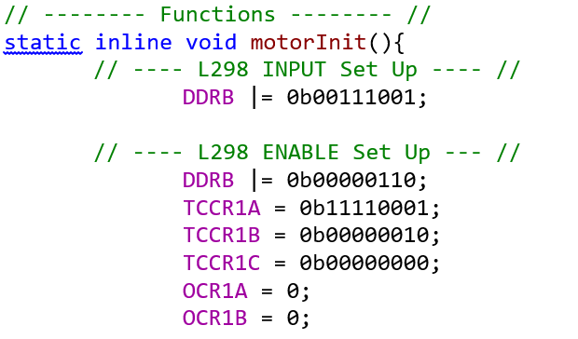
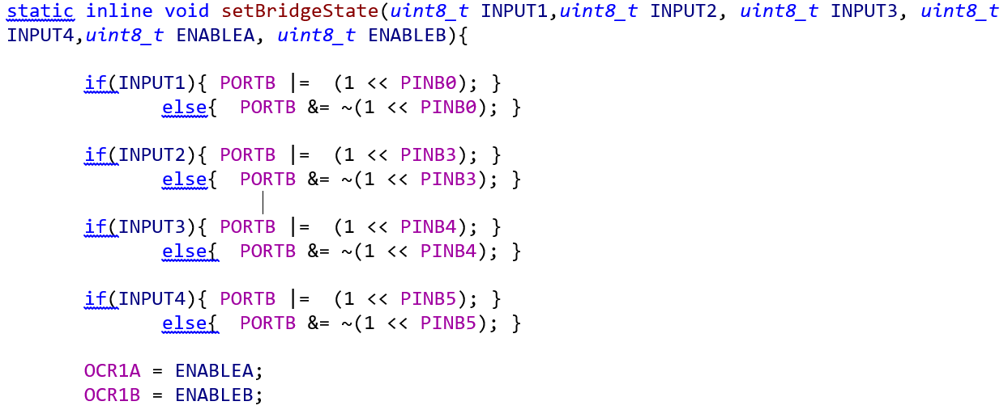
Task 4
DC Motor Control Setup

Slide 40
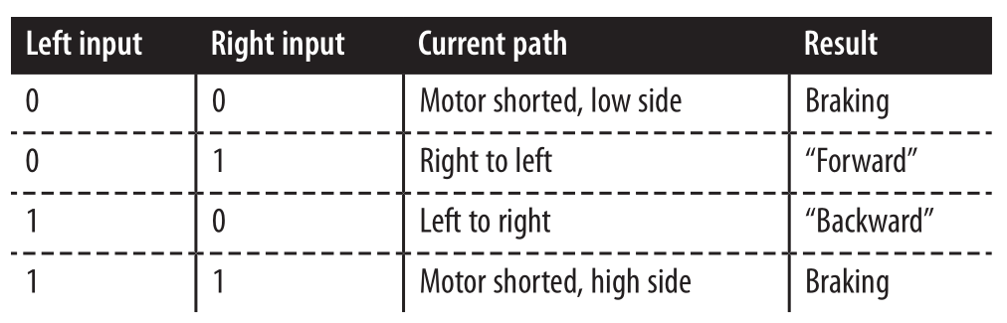
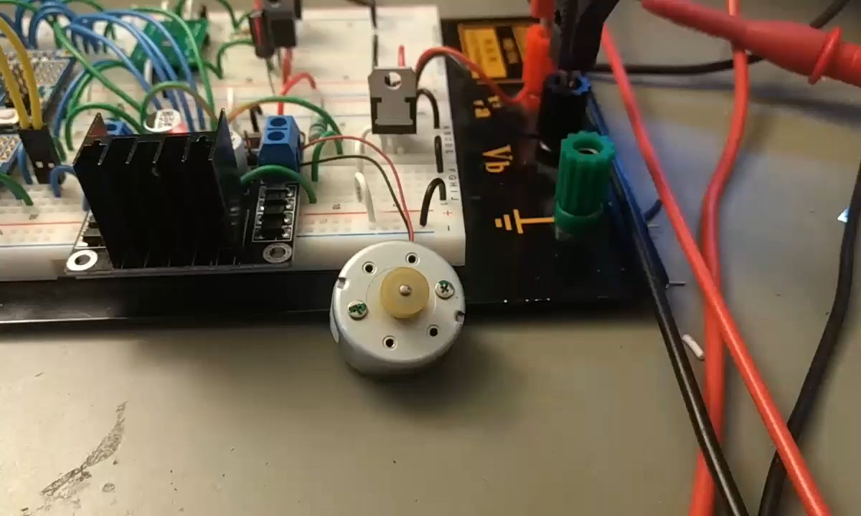
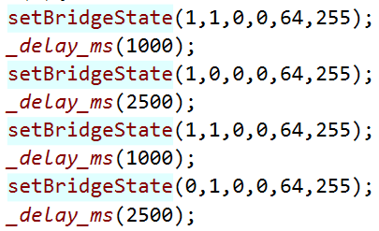
Task 4
DC Motor Control Setup

Slide 41
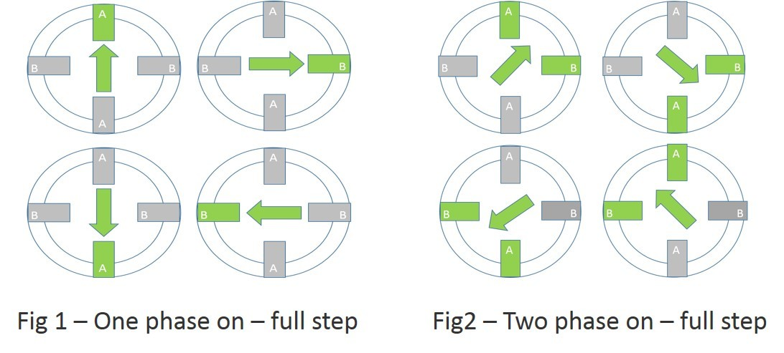
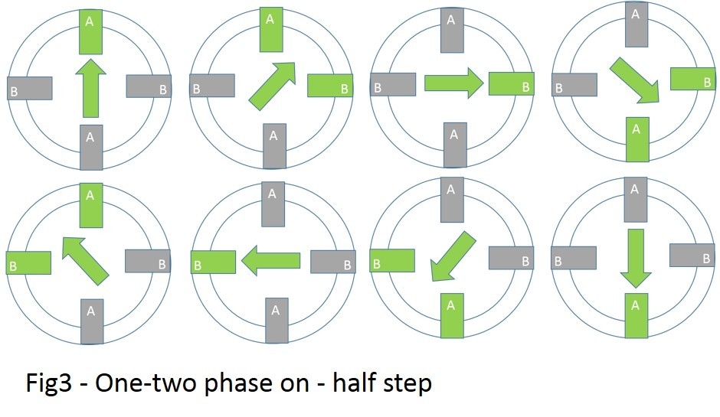
Task 4: Design Verification Motor Control
Full, Half, and MicroStepping
Full and Half stepping relies on input logic.
Microstepping varies power to each winding in varying proportion.
PWM to vary power by duty cycle

Slide 42
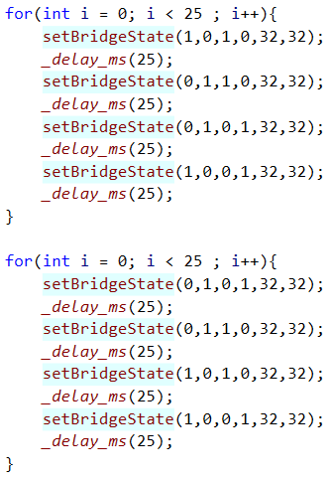
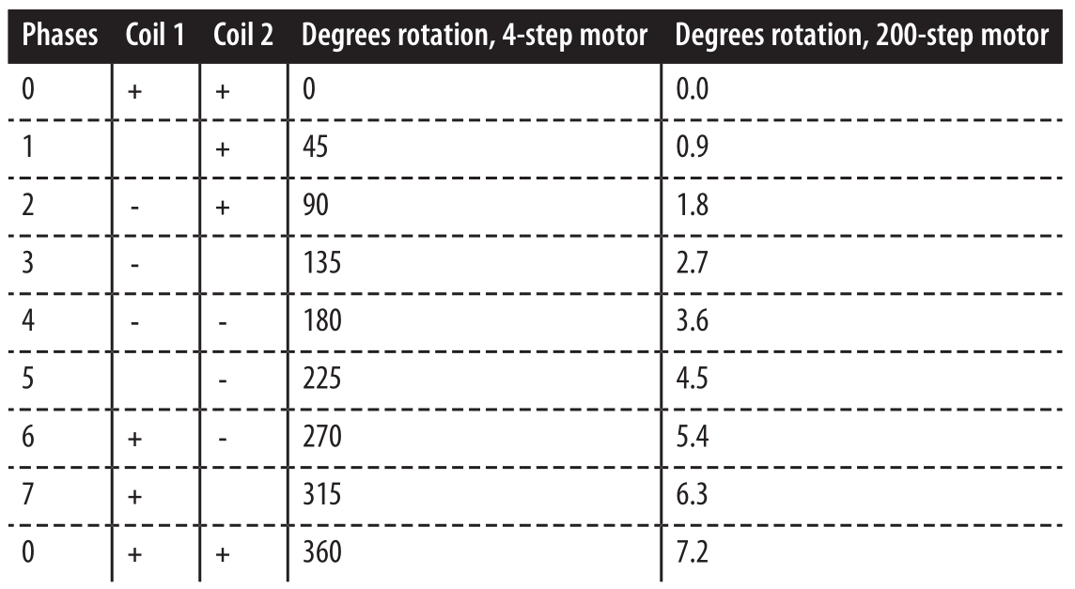
Task 4
Stepper Motor Control Setup

Slide 43
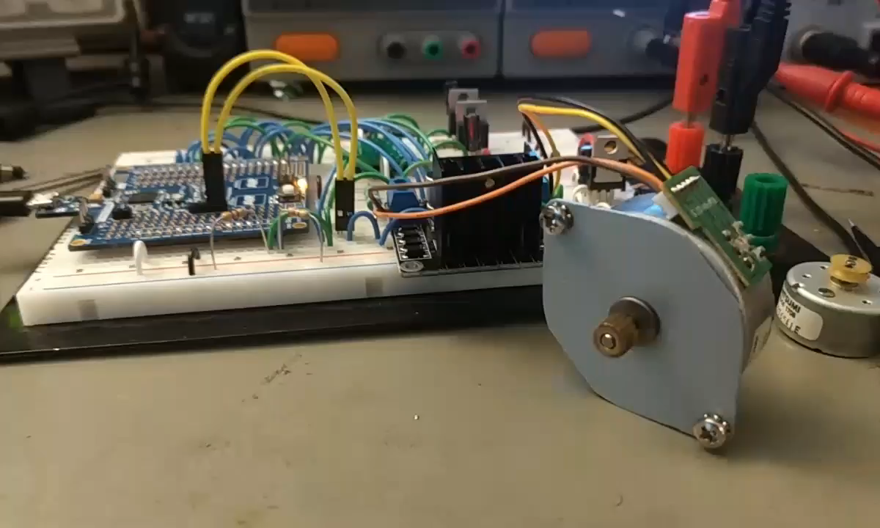
Task 4
Stepper Motor Control Setup

Slide 44
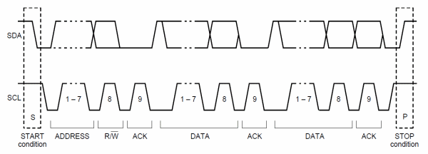
Task 1 Control Section Design Microcontroller: I²C
Serial communication protocol transfers information one bit at a time.
Addressed devices are connected to same line
Devices respond when they see their address after the start condition.

Slide 45
Task 4

Slide 46
Task 5 : PCB Design

Slide 47



Task 5
PCB Design:
OSHPARK design rules
6 mil minimum trace width
6 mil minimum trace spacing
10 mil minimum drill
5 mil minimum annular ring
1.4 mil copper thickness

Slide 48

Task 5
PCB Design:
Trace Width Calculation
$$I=K {∆T}^{0.44}{\left(WH\right)}^{0.725}$$
$I$ = current W = trace width(mils H = copper thickness(mils)
$∆T$ = Temperature Rise K = 0.048 for external traces
Approximate Maximum Current Draw 10.0A = 325 mil
Approximate Adjustable Supply Draw 5.0A = 125 mil
Approximate 5V supply current draw 1.5A = 25 mil
Minimum trace width draw 6 mil = 0.55A

Slide 49

Finalized PCB in Circuit Maker

Slide 50


Finalized PCB in Circuit Maker

Slide 51


OSHpark Production Render

Slide 52


OSHpark Production Results

Slide 53
Task 6 : Assembly and Testing

Slide 54



Task 5
Visual Inspection Results:
Improper Footprint Design and Troubleshooting

Slide 55


Task 5
Continuity Testing:
Improper Component Design and Workaround

Slide 56

Soldering SMD Components

Slide 57

Solder TMT Components and Connectors

Slide 58


Task 3 Programming/ Debugging Design: AVR-ISP connector
AVR Devices are initially programmed through a 6 or 10 pin header connected to pins on the microcontroller
This device will use a 6 pin header
Needed to install bootloader that runs programs and allows for serial programming through usb e.g. Arduino
Single wire debugging is done through reset pin of isp header

Slide 59

Task 4
Programming/Debugging:
Sparkfun Pocket AVR Programmer
Inexpensive
Can program all microcontrollers supported by AVRDUDE
Works with microcontrollers with 64KB or less memory
Also supports single wire debugging

Slide 60
Questions?

